Slide 1





International University - VNU HCMC
Final Project - (2024 - 2025 Semester 01)
IT069IU - Object-Oriented Programming
Tetris Game
Presented by: DNAT Group

Slide 2
About our group
Le Vo Hong Na - ITITSB23007
Pham Quang Tuong - ITDSIU20108
Nguyen Nhat Anh - ITITSB23006
Nguyen Nhat Duy - ITITWE22143

Slide 3
Table of Contents
Introduction
What is Tetris game
Tetris Objects
UML diagrams
How to play the game

Slide 4
Introduction
This is our OOP final project - a Tetris game
This project demonstrates key OOP principles that we have learned in this OOP course like encapsulation, inheritance, and polymorphism.

Slide 5
What is Tetris game
Tetris game, which was created in 1984 by Alexey Pajitnov, is a classic puzzle game genre associated with many generations.
When a line is successfully formed, it disappears, and the player earns points. As the game progresses, the falling blocks increase in speed, adding to the difficulty and excitement.

Slide 6



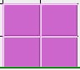



Tetris Objects
Normal level:
7 basic kinds of shapes:

Slide 7
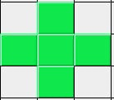
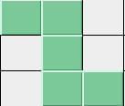


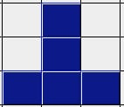

Tetris Objects
Hard level
Extreme level

Slide 8
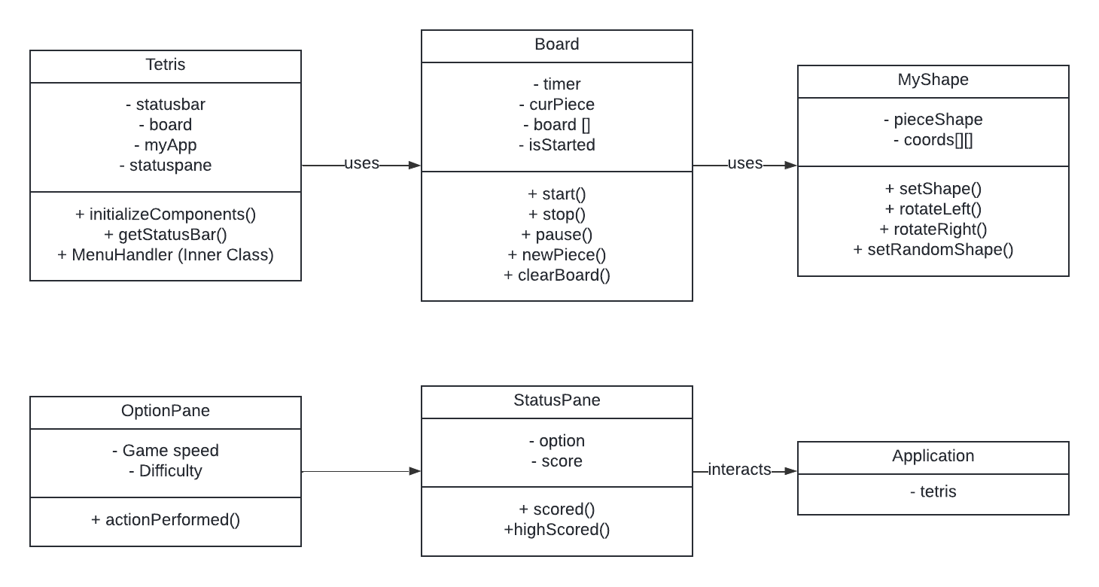
UML diagrams

Slide 9
How to play
Step 01: Click Start game to begin the new game
Step 02: Using your keyboard to operate the shapes
“S” key: Increase the shapes’ speed
“P” key: Pause the game
Space key: Drop the shapes immediately
Arrow key: Rotate the shapes to fit
Besides, you can also use the Setting to adjust the speed and difficulty

Slide 10
Demo video

Slide 11
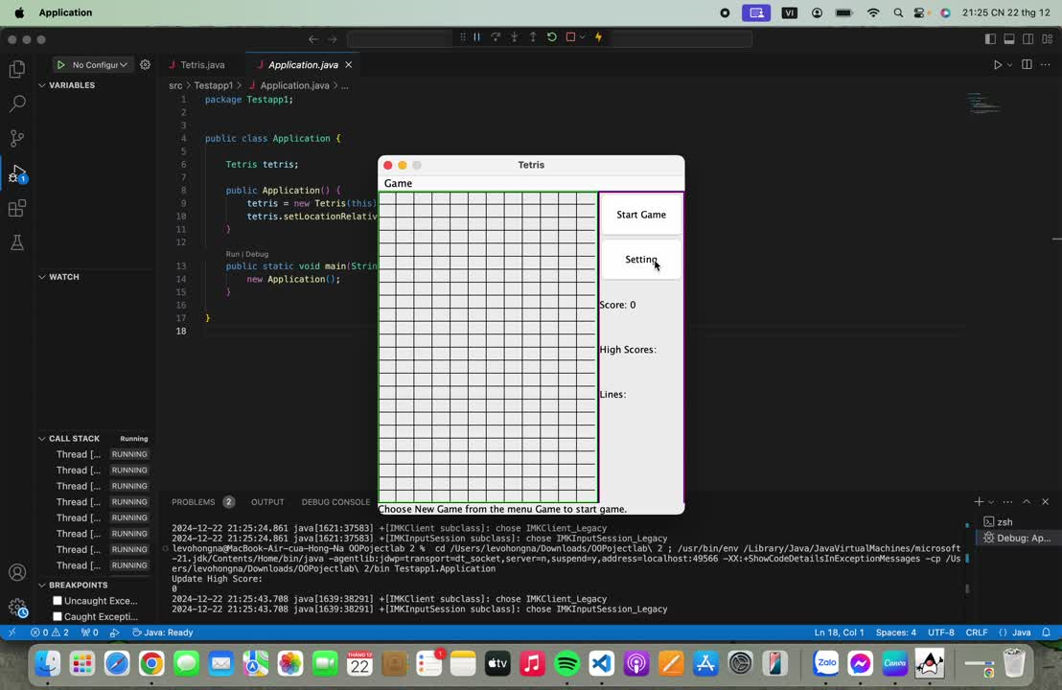

Slide 12
Thank you
for listening

